Slide 1



Sentiment Analysis Project
Using Machine Learning and Natural Language Processing

Slide 2


OBJECTIVE
Analyze textual data and classify sentiments.
Develop ML/DL models to predict user emotions.
Demonstrate real-world applications in reviews, social media, and feedback.
02

Slide 3


Abstract
This project applies Natural Language Processing (NLP) and Machine Learning to analyze text data.
By preprocessing, vectorizing, and training models, we classify sentiments as positive, negative, or neutral.
The project highlights AI’s ability to interpret emotions from text and its impact on decision-making in various domains.
03

Slide 4

PLATFORM (SPECS OVERVIEW)
OS: Windows 10 / Ubuntu
Processor: Intel i5/i7 or AMD Ryzen
RAM: 8–16 GB
Storage: 500 MB+
GPU (Optional): NVIDIA CUDA cores for DL models
04

Slide 5

PLATFORM (HARDWARE REQUIREMENTS)
Processor: Intel i5/i7
RAM: Minimum 8 GB (16 GB recommended)
Storage: 500 MB project space
GPU: Optional (for Deep Learning models)
05

Slide 6

PLATFORM (SOFTWARE REQUIREMENTS)
Python 3.9+
Jupyter Notebook / Anaconda
Libraries:
NLTK
Scikit-learn
TensorFlow / Keras
Matplotlib / Seaborn
06

Slide 7


LITERATURE REVIEW
Past studies relied on Naïve Bayes, SVM, Logistic Regression.
Deep Learning models like RNN and LSTM improved performance.
Recent advancements: Transformer models (BERT, RoBERTa) achieving state-of-the-art results.
07

Slide 8

INTRODUCTION TO NLP
NLP = Processing human language with computers
Key tasks: Tokenization, Stopword Removal, Lemmatization
Bridges the gap between raw text and machine understanding
08

Slide 9

SENTIMENT TYPES
Positive → “I love this product!”
Negative → “The service was terrible.”
Neutral → “The package arrived yesterday.”
09

Slide 10
DATASET COLLECTION
Sources:
Twitter (Tweets)
IMDb Reviews
Amazon Product Reviews
Dataset size: 10,000+ records
Format: CSV / Text
10

Slide 11
DATA PREPROCESSING
Remove punctuation & special characters
Convert text to lowercase
Remove stopwords
Lemmatization / stemming
Tokenization
11

Slide 12
TEXT PROCESSING
Tokenization → Splitting into words
Stopword Removal → Eliminating irrelevant words
Lemmatization → Reducing words to root form
12

Slide 13
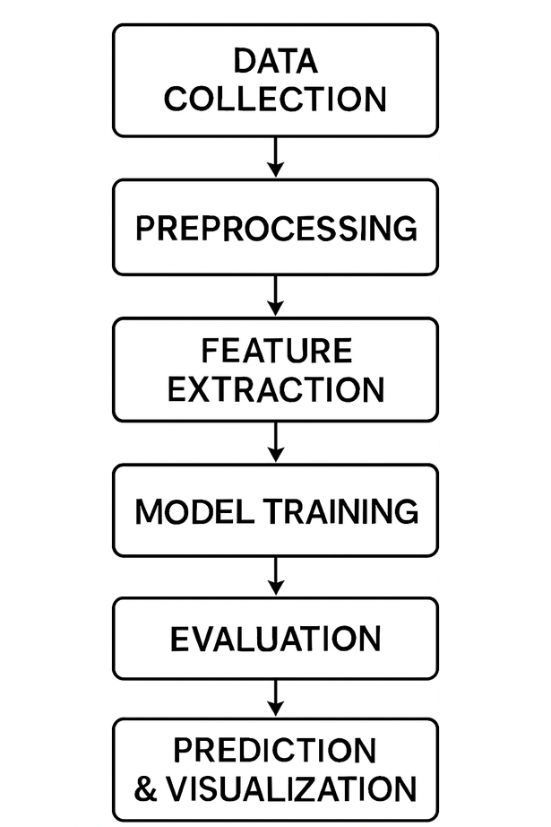
PROJECT FLOWCHART
13

Slide 14
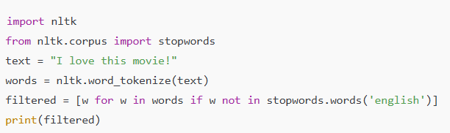
SOURCE CODE (PREPROCESSING EXAMPLE)
14

Slide 15
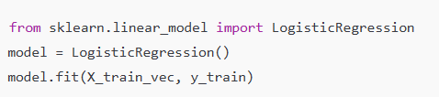
SOURCE CODE (TRAINING EXAMPLE)
15

Slide 16
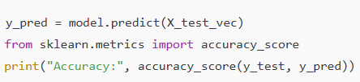
SOURCE CODE (PREDICTION & EVALUATION)
16

Slide 17
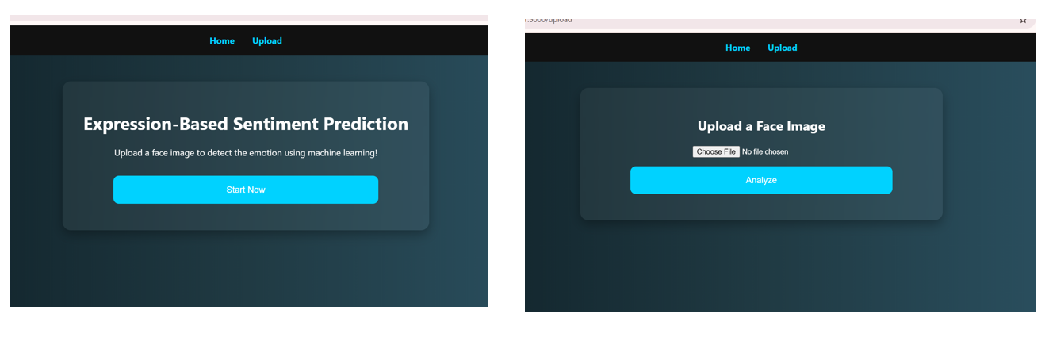
OUTPUT IMAGES
17

Slide 18
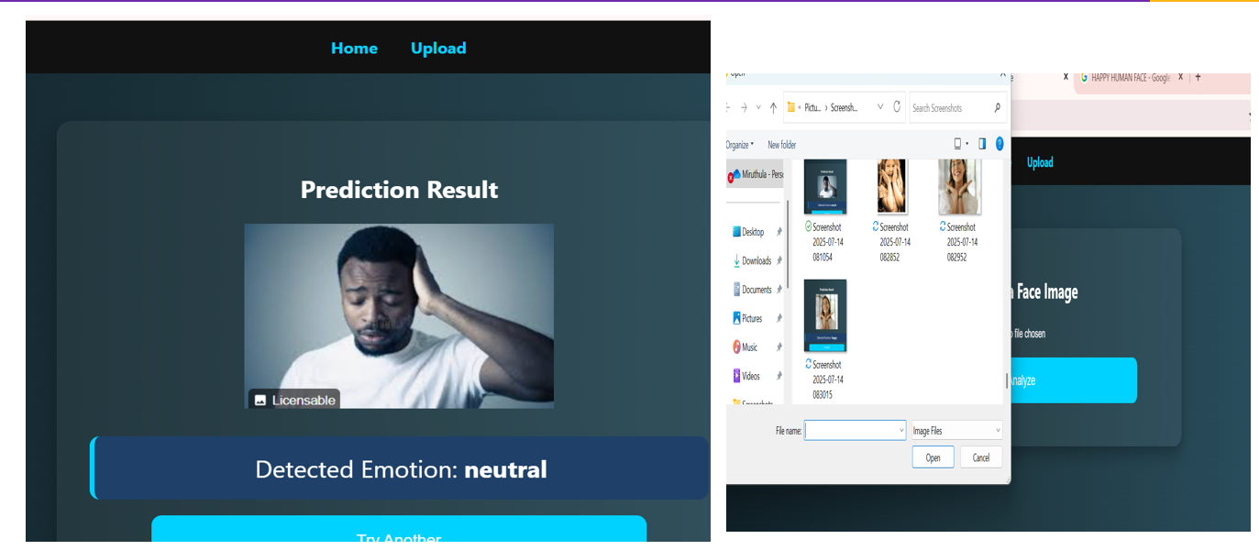
OUTPUT IMAGE
18

Slide 19
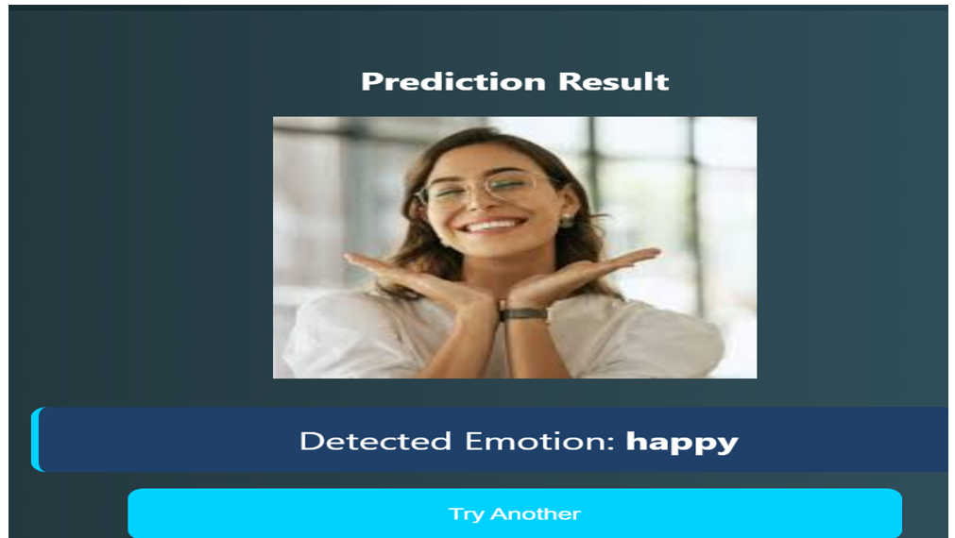
OUTPUT IMAGE
19

Slide 20
TECHNICAL SKILLS LEARNED
Python Programming: Utilized extensively for image processing, model integration, and real-time emotion prediction.
OpenCV: Used for face detection, image acquisition from webcam, preprocessing, and real-time visual display of predicted emotions.
TensorFlow / Keras: Built and trained a Convolutional Neural Network (CNN) for facial expression classification and saved the trained model (expression_model.h5).
NumPy: Employed for numerical operations on image data and matrix transformations required in preprocessing.
Matplotlib & Seaborn: Visualized training accuracy/loss and evaluated model performance using confusion matrices and classification plots.
Data Preprocessing: Performed operations like grayscale conversion, resizing, normalization, and label encoding for effective model input.
Model Evaluation: Applied classification metrics such as accuracy, precision, recall, F1score, and confusion matrix to assess performance.
20

Slide 21
CONCLUSION
The project successfully demonstrated sentiment classification using NLP and ML. Deep learning improved accuracy, while transformer-based models achieved the best results. Future work will focus on real-time applications and multi-language support
21

Slide 22
THANK YOU
BY:
SEMMOZHI K
REG.NO: 25024u09040
NMN :astvu25025024u09040
DEPARTMENT OF BACHELOR OF COMPUTER APPLICATIONS
Skp arts and science college

